Slide 1

Smartphone-based hard-braking event detection at scale for road safety services
27 Sep

Slide 2
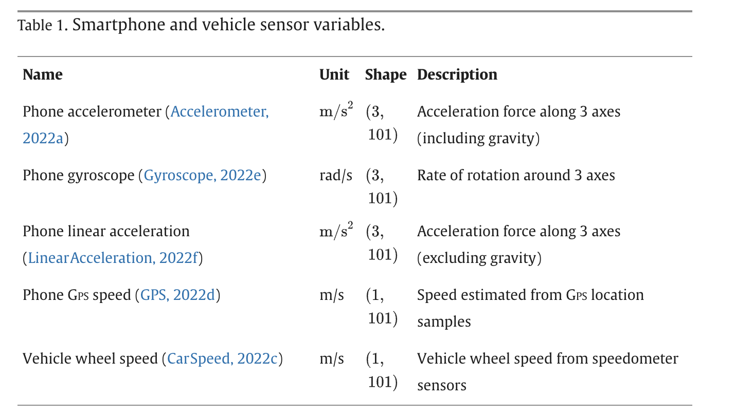
Goal build a classification model to detect harsh brake
Input:
Output: vehicle wheel speed as labels
𝑙𝑎𝑏𝑒𝑙 = (𝑚𝑖𝑛(𝐴𝑐𝑐𝑒𝑙𝑣_𝑙𝑜𝑛𝑔 ≤ −5))
𝐴𝑐𝑐𝑒𝑙𝑣_𝑙𝑜𝑛𝑔 = 𝑑 (𝑆𝑝𝑒𝑒𝑑𝑣 ) ∕𝑑𝑡

Slide 3
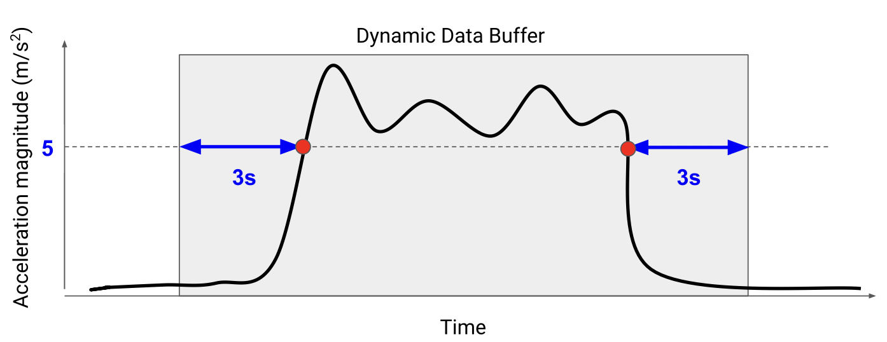

Slide 4
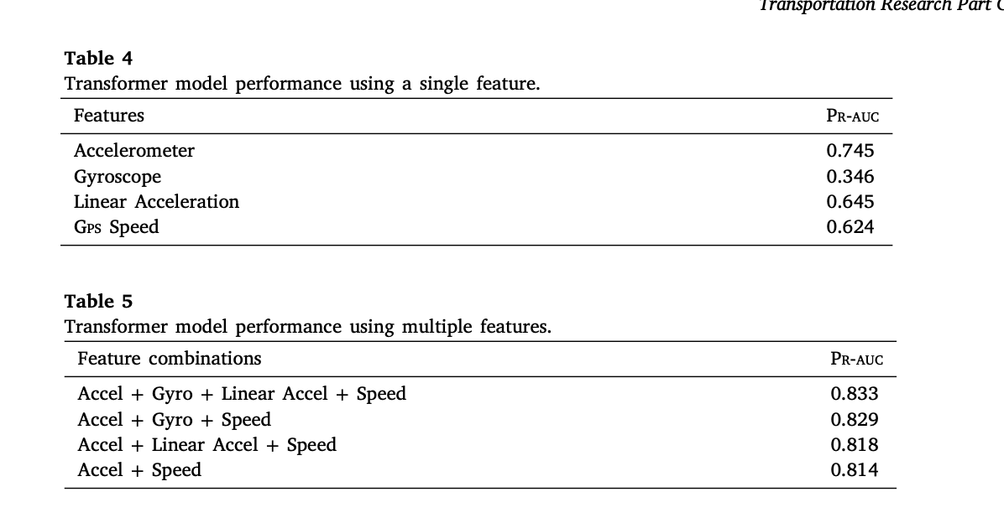
Results:
Luyang Liu, David Racz, Kara Vaillancourt, Julie Michelman, Matt Barnes, Stefan Mellem, Paul Eastham, Bradley Green, Charles Armstrong, Rishi Bal, Shawn O’Banion, Feng Guo,
Smartphone-based hard-braking event detection at scale for road safety services, Transportation Research Part C: Emerging Technologies, Volume 146, 2023,

